Slide 1
Burns and its Management
Mr Riad Hosein
MBBS MRCSED MCEM
ST5 EM QMC

Slide 2
Contents
List and differentiate the categories of burn injury
Describe the pathophysiology of each burn category
Classify the depth of burn injury
Describe and apply the rule of nines
List the causes, symptoms and signs of inhalation injury
Outline the fluid resuscitation of burns patients, including composition, volume and timing of fluid
List the other management steps in the initial 24 hours following a burn injury, including general support, wound management and antibiotics

Slide 3
Definition
Burns
  Injuries caused by direct or indirect contact with heat, friction,electrical current, radiation, or chemical agents

Slide 4
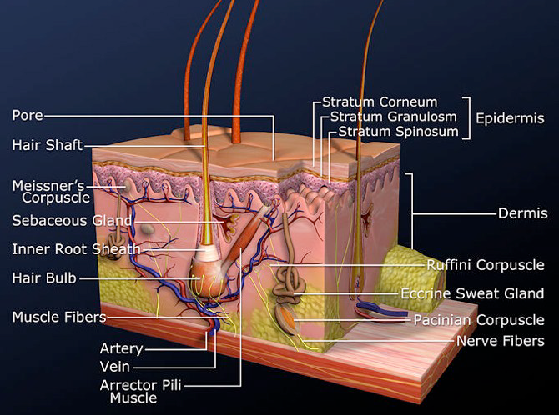
Anatomy Physiology
Largest organ-15% BW
1.5-2 m²
Most 2-3mm thick
Temperature Reg
Immune
Vitamin D
Sensation
Water retention

Slide 5

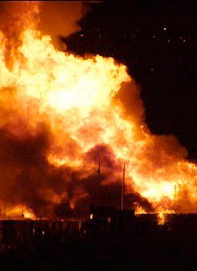

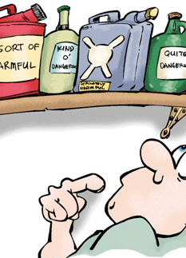
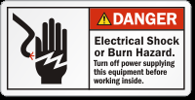
Types
Thermal
Chemical
Friction
Radiation
Electrical

Slide 6
Causes of death in burn patients
Circulation: “failure of resuscitation”
  Cardiovascular collapse, or acute MI
  Acute renal failure
  Other end organ failure
Missed non-thermal injury
Airway

Slide 7
Primary Assessment
Airway / Breathing
Assume cervical spine injury
  Effects of facial/mandibular fracture
  Laryngeal/tracheal injury
  ecchymosis, hoarseness, edema, subcutaneous air
  Flail chest from rib fractures Pneumo- / hemothoraces
  Potential airway involvement
    soot or singing involving mouth, nose, hair, face, facial hair coughing, black sputum

Slide 8
Circulation
Record vital signs
Check distal pulses and nail beds
  Keep warm
  Loss of skin impairs ability to retain heat and fluids
  Being cold will cause vasoconstriction
Monitor urine output (large burns, insert catheter for urine output). 30-50ml/hr
When available, monitor electrolytes

Slide 9
Neuro status
The burn itself does not alter the level of consciousness
If patient is not alert, think of other causes:
  hypovolemia
  carbon monoxide
  head injury
Don’t allow swollen eyelids to prevent you from examining the pupils
Test sensation and motion in burned extremities

Slide 10
Local/Systemic Effects
Local
  Loss of thermoregulation barrier immune/water retention function
  Inflammatory response and pain
Systemic (more severe burns)
  Increased haematocrit early, anaemia later
  Hypothermia, hypovolaemia, hyperkalaemia
  Reduced immunity
  Renal damage from myoglobin
  Cardiac output reduced in >60% burns
  Stress ulcers in stomach

Slide 11
Zones of Burn Wounds
Zone of Coagulation
  devitalized, necrotic, white, no circulation
Zone of Stasis ‘circulation sluggish’
  may covert to full thickness, mottled red
Zone of Hyperemia
  outer rim, good blood flow, red

Slide 12
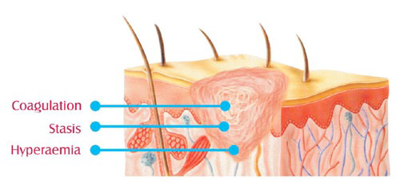

Slide 13
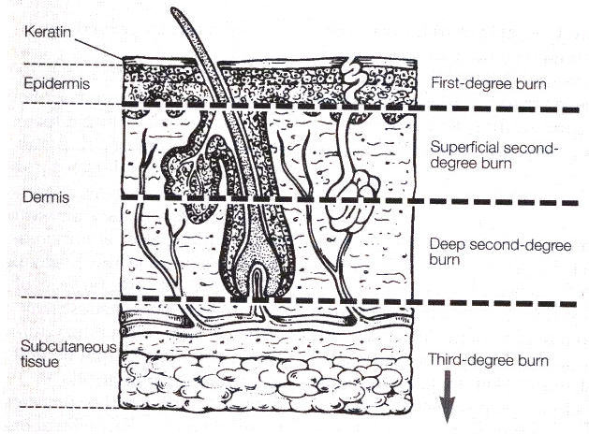

Slide 14
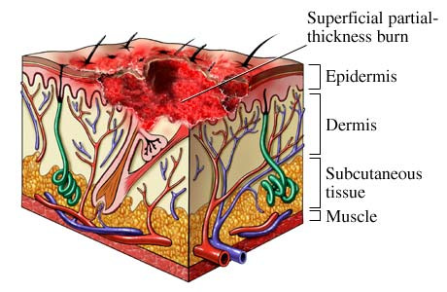
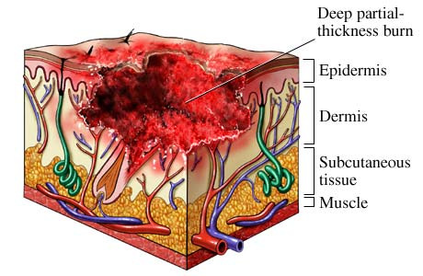
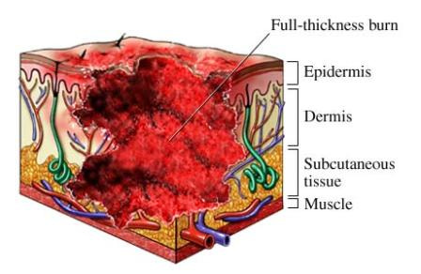

Slide 15
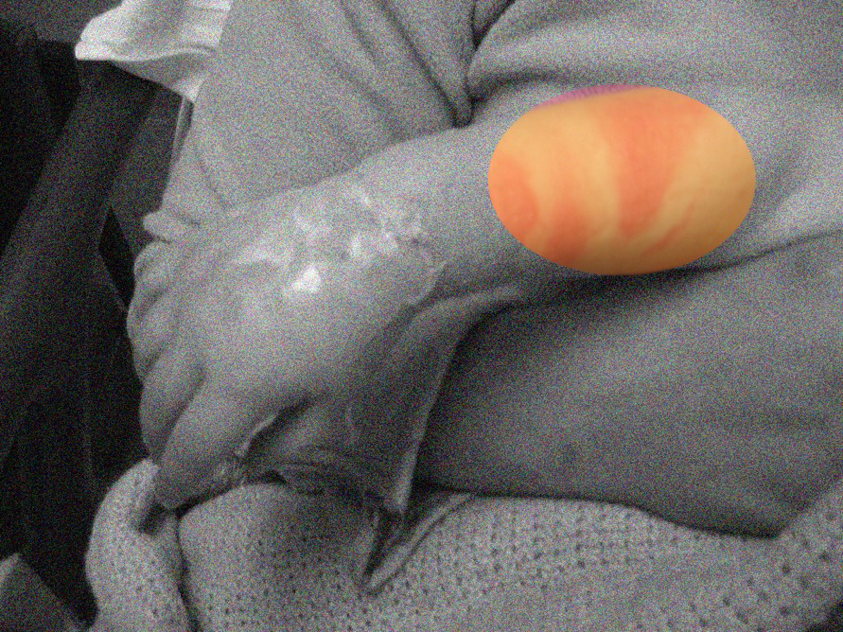
Superficial
Depth:
  Erythema eg sunburn
  Painful
  Blanching
  No blistering
  Heals in 3-6 days
  No scaring
  Topical creams provide relief
  No Ax
Don’t include in surface area calculations

Slide 16
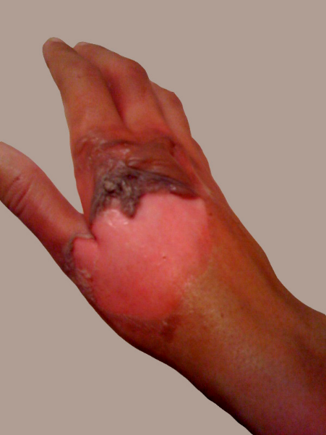
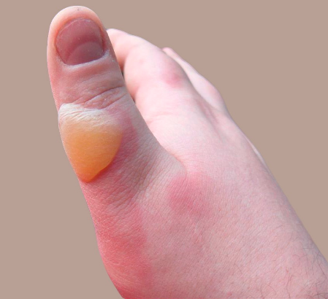
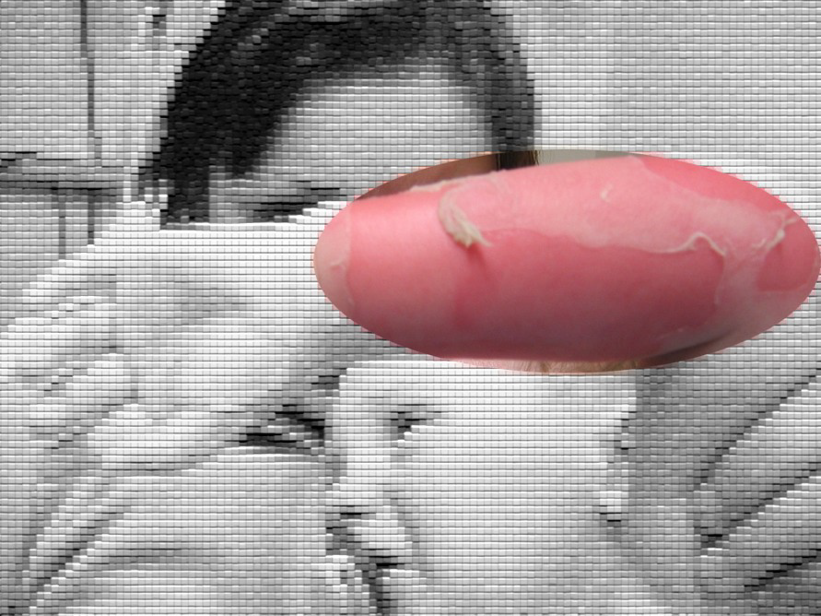
Partial thickness burns
Blisters are typical of partial thickness burns.
Don’t be in a hurry to break the blisters.
Heals in 14-21 days
Blisters provide biologic dressing and comfort.
Once blisters break, red raw surface will be very painful.

Slide 17
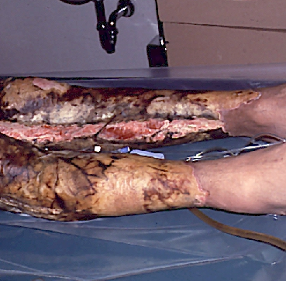
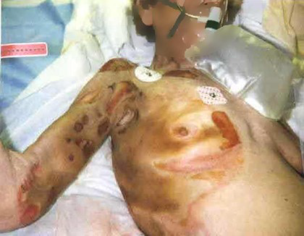
Full thickness
Entire thickness
Minimal pain
Non-blanching
Leathery/waxy
No sensation (nerve endings destroyed)
Charred
Needs grafting

Slide 18
Management
Ensure rescuers safety
Caution/Remove source (prehospital)
Airway risk (carbon sputum, singed nasal hair, hoarse voice, etc) early intubation
O2/IV access and fluids urinary catheter
Analgesia
  (Entonox/morphine/ paracetamol NSAID))
Assess depth and percentage surface area
Cover (cling film then dressings)
Refer?

Slide 19
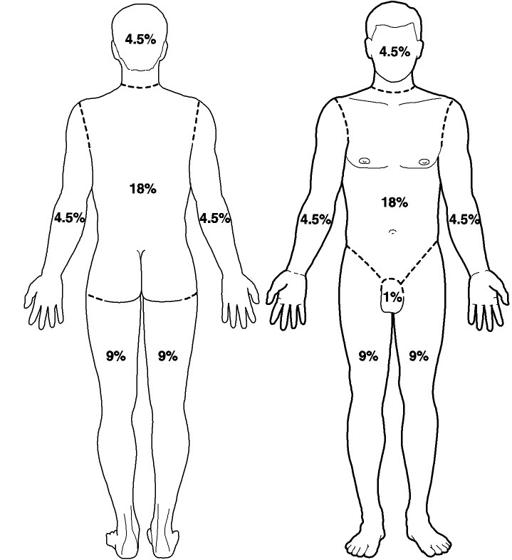
Assessment
Surface Area
Rule of Nines (Wallace)

Slide 20
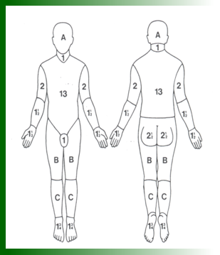
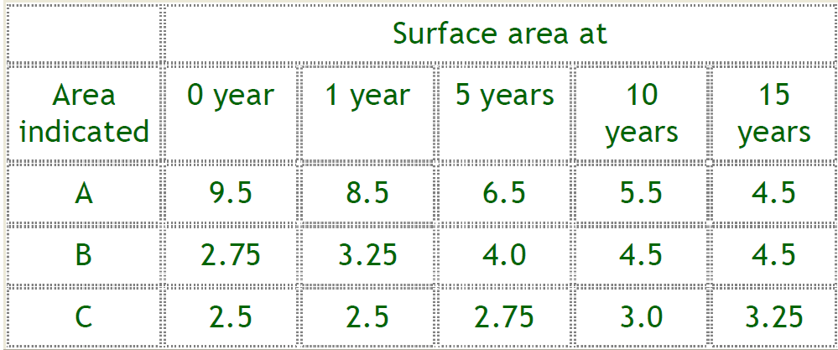
Lund and Browder chart

Slide 21
IV fluids-Parkland
>20% BSA adults, >10% paeds
4ml x kg x % BSA Ringers Lactate or Hartmann's /24 hrs
Half in the first 8 hours following burn
Other half over 16 hours

Slide 22
Management
Analgesics
Fluids/ ax/ tetanus
Airway management
Input output charting
Vte
Other injuries
Plastics ortho itu

Slide 23
Burns of special areas of the body
Face
Mouth
Neck
Hands and feet
Genitalia

Slide 24
Face
Be VERY concerned for the airway!!
Inhalation injuries
Eyelids, lips and ears often swell alarmingly
Worse the next day /6hrs later
Improve daily thereafter
Cleanse eyes with warm water or saline.
Apply antibiotic ointment or liquid tears until lids are no longer swollen shut
Ophthalmology referral
Polyfax cream/ointment to face

Slide 25
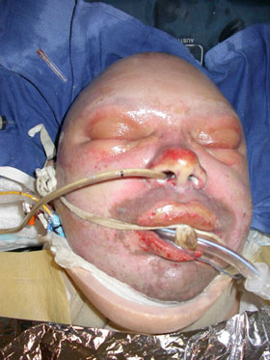

Slide 26
Inhalation Injury
Smoke
Household agents eg bleach
Industrial gases
Airway irritation, oedema, tracheitis, bronchitis
ARDS

Slide 27
Escharotomy
Deep circumferential burns
  Neck/ Limb/ Chest
Consult Burns Unit first

Slide 28
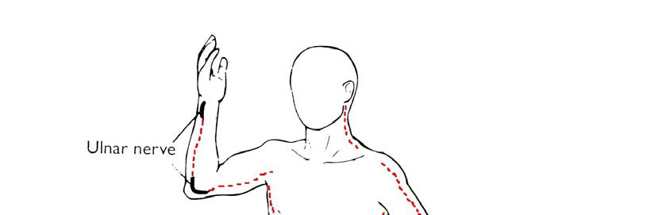
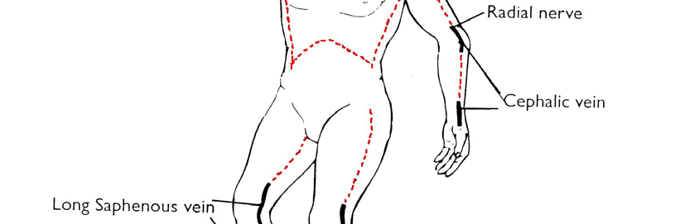
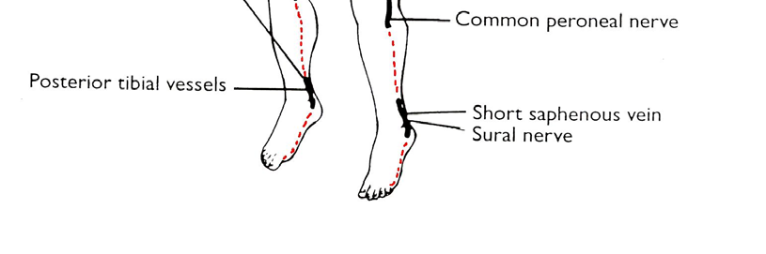

Slide 29
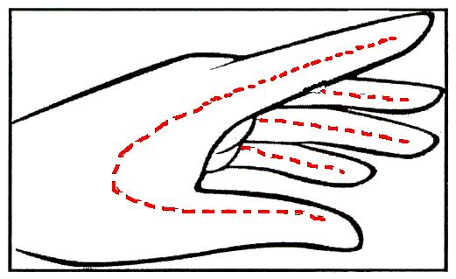

Slide 30
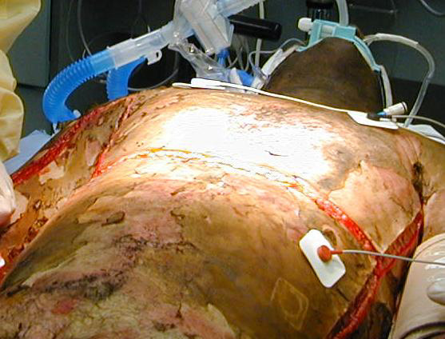

Slide 31
Chemical Burns
Brush first if powder
Wash with water ++, 20-30mins
DO NOT use neutralising agents
Alkali worse than acid
Liquefactive vs coagulative necrosis

Slide 32
Electrical Burns
Current kills, voltage simply determines whether current can enter the body Ohm’s law: I=V/R
Electrical follows shortest path
Low Voltage usually cannot enter body unless:
  Skin is broken
  Moist (follows blood vessels/nerves)
High Voltage easily overcomes resistance

Slide 33
Electrical Burns Pathophysiology
Most damage done is due to heat
External Burn
Internal Burn
Musculoskeletal injury
Cardiovascular injury
Respiratory injury
Neurologic injury
Rhabdomyolysis and Renal injury

Slide 34
Electrical Burn Management
Make sure current is off
Lightning hazards
ABC’s Ventilate and perform CPR as needed
Oxygen ECG monitoring
Treat dysrhythmias
Rhabdomyolysis Considerations Fluid?
Assess for additional injuries

Slide 35
Radiation Exposure
Waves or particles of energy that are emitted from radioactive sources
α radiation large
  travel a short distance
  minimal penetration
  inhaled , ingested or absorbed
β radiation small
  more energy
  more penetrating ability
  enter thru damaged skin, ingestion or inhalation
γ radiation & X-rays
  most dangerous penetrating
  may produce localized skin burns and extensive internal damage

Slide 36
Whom to Refer?
FTB >5%
Electrical + Chemical
Inhalational
Involving special areas (hands/feet/face/genitalia)
PTB >15% (>10% if age <10 or > 50)
Other serious coexistent medical illnesses

Slide 37
IN A CHILD
Non-accidental injury – a possibility
“Glove and stocking” scalds, or artefact shape burns
Be alert abuse or neglect
ABCD’S, SOCIAL SERVICES THEN PAEDS!!!!!!!!!

Slide 38
Follow Up
All burns within 24-48 hours, except minor superficial burns
Patient advice re-infection and return if any
Systemic upset/fever (staphylococcal sepsis)
May still need referral

Slide 39
Summary
Local and systemic effects of burns
Superficial, Partial thickness and Full thickness in depth
Assess surface Area
ABCD then IV fluids 4ml/kg/%
Don’t forget analgesia/ tetanus

